Slide 1


SIMATS ENGINEERING
SAVEETHA INSTITUTE OF MEDICAL AND TECHNICAL SCIENCES
Integrated Healthcare Portal for Patient Records, Appointments and Reports
CSA4303 – Internet Programming
Date : 29-10-2026 Team : 08
Guided by:
Dr. Krishnaraj Mony
Associate Professor/CSE
Presented by:
Karthick balaji (192324216)

Slide 2


INTRODUCTION
Manual healthcare operations: Many small and medium clinics still rely on paper records, manual appointment books, and handwritten prescriptions for their daily work.
Integrated healthcare portal: This project builds “MedTrack”, a browser-based portal that digitises patient records, appointment scheduling, and report generation in one platform.
Three user roles: Patients self-register and book slots, Doctors update diagnoses and prescriptions, and Administrators oversee the entire system.
Real-time booking: AJAX-based availability checking shows live doctor slots and prevents double bookings without any page reload.
Core web technologies: Built with HTML5, CSS3, JavaScript, AJAX, PHP/JSP, MySQL, and XML; XML prescriptions are transformed by XSLT into printable PDF reports.

Slide 3
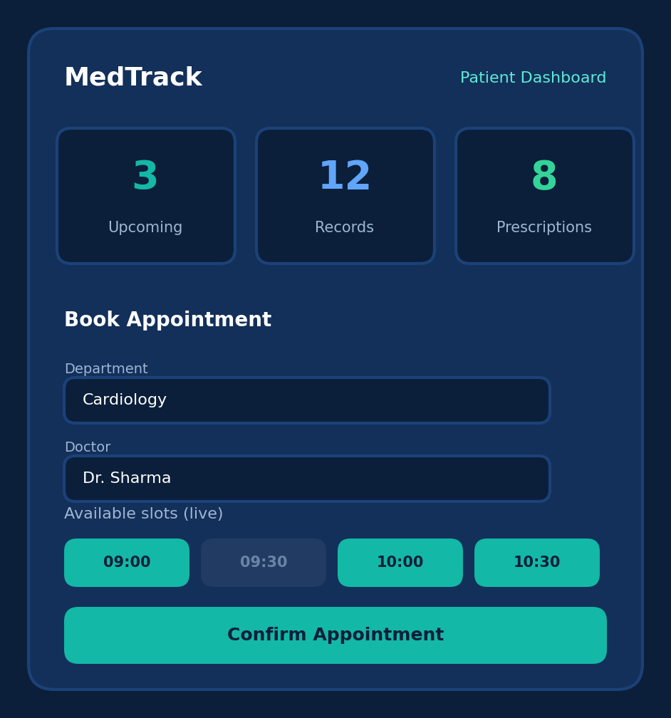
OBJECTIVES
Secure Multi-Role Portal: Develop a web application with session-based authentication for Patients, Doctors, and Admins.
Real-Time Availability: Check doctor availability and time slots instantly using AJAX, with no page reloads.
Structured Patient Records: Create, edit, and retrieve patient history, diagnoses, and prescriptions using MySQL.
XML Report Generation: Generate downloadable PDF prescriptions and visit summaries from XML data using XSLT.
Responsive & Modular Design: Apply MVC architecture with CSS3 Flexbox/Grid so clinic staff can use tablets and mobiles.

Slide 4
LITERATURE SURVEY
S.No | Title | Authors | Year | Techniques Used | Problem Addressed
1 | Internet Patient Records: new techniques | G. Brelstaff, S. Moehrs, P. Anedda, M. Tuveri, G. Zanetti | 2021 | XML, XSL, DOM, JavaScript, JavaBeans | Building interactive, standards-based web clients for electronic patient records
2 | Usage of XML Technology in Electronic Health Record for Effective Heterogeneous Systems Integration in Healthcare | C. S. Kumar, A. Govardhan, C. V. Guru Rao | 2019 | XML Schema, HL7, DICOM, UML | Integrating heterogeneous patient record structures across healthcare systems
3 | Online Appointment Management System for New Philip Hospital | H. D. D. Madushan | 2024 | PHP, MySQL, Apache, Rational Unified Process | Costly third-party booking services that lack hospital-specific features
4 | A Review on the Information System, and Development of Appointment Management System | S. U. Kazal, B. Ahammed, M. K. Hassan, et al. | 2021 | PHP, MySQL, jQuery, JavaScript, HTML/CSS | Difficulty booking doctor appointments online without patient, doctor, and admin modules
5 | Appointment System using Artificial Intelligence Techniques | F. Al-Turjman | 2023 | PHP, MySQL, jQuery AJAX, JavaScript, Python ML | Booking clashes and congestion in traditional appointment booking systems

Slide 5
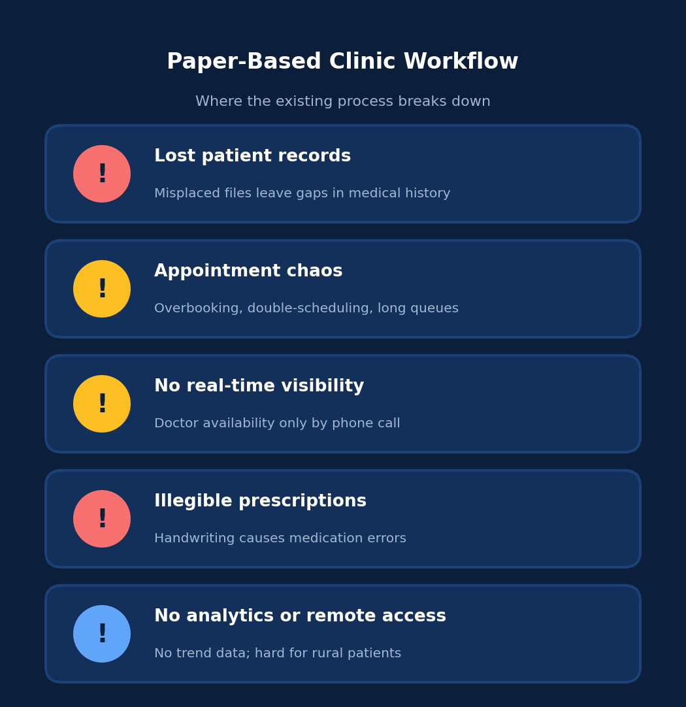
EXISTING SYSTEM
Paper-Based Records: Patient files are kept physically and are easily misplaced, creating dangerous gaps in medical history.
Manual Appointment Books: Overbooking, double-scheduling, and long waiting queues frustrate patients and doctors.
No Real-Time Visibility: Patients cannot check doctor availability without calling the clinic.
Handwritten Prescriptions: Illegible handwriting often causes dangerous medication mistakes.
No Analytics or Remote Access: Clinics cannot track visit trends or recurring diagnoses, and elderly or rural patients struggle to travel for follow-ups.

Slide 6
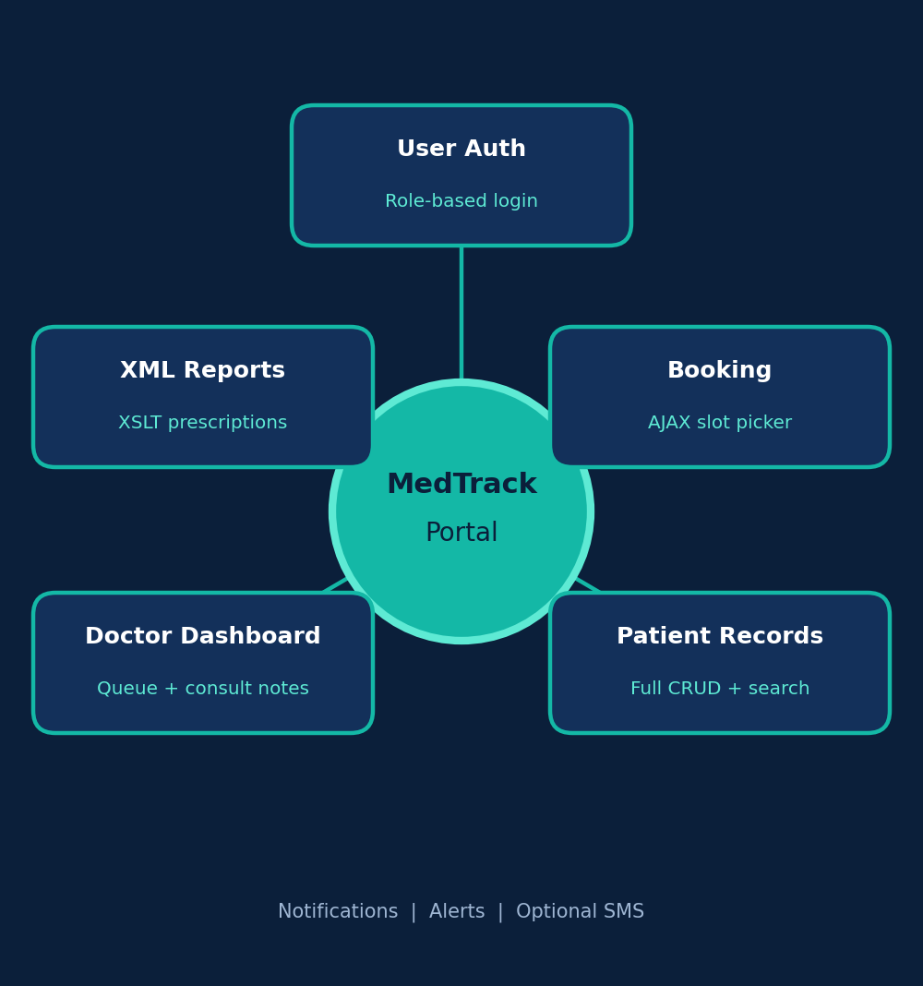
PROPOSED SYSTEM
Role-Based Authentication: Secure login for Patients, Doctors, and Admins with hashed passwords, CSRF tokens, and 30-minute session timeout.
Real-Time AJAX Booking: Patients pick department, doctor, and live time slot without page reloads, preventing double bookings.
Centralised Patient Records: MySQL-backed records for history, allergies, diagnoses, and lab uploads, with instant AJAX live search.
Doctor Dashboard & Alerts: Doctors view the daily queue and update consultation notes, while patients receive in-app notifications.
XML/XSLT Report Generator: Prescriptions stored as XML are transformed by XSLT into printable HTML and downloadable PDF reports.

Slide 7
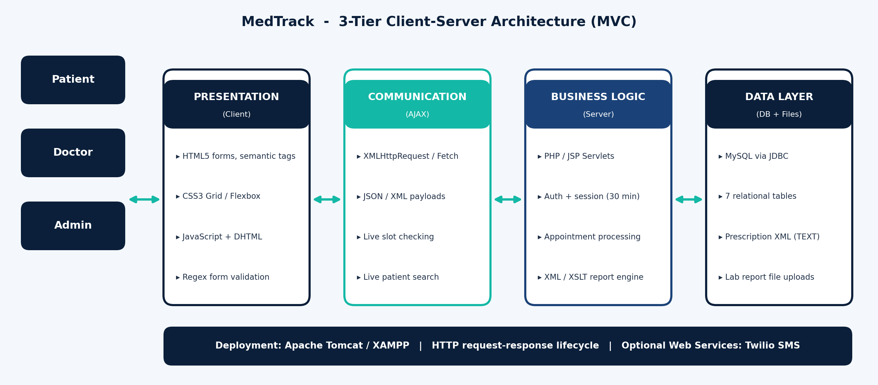
ARCHITECTURE DIAGRAM

Slide 8
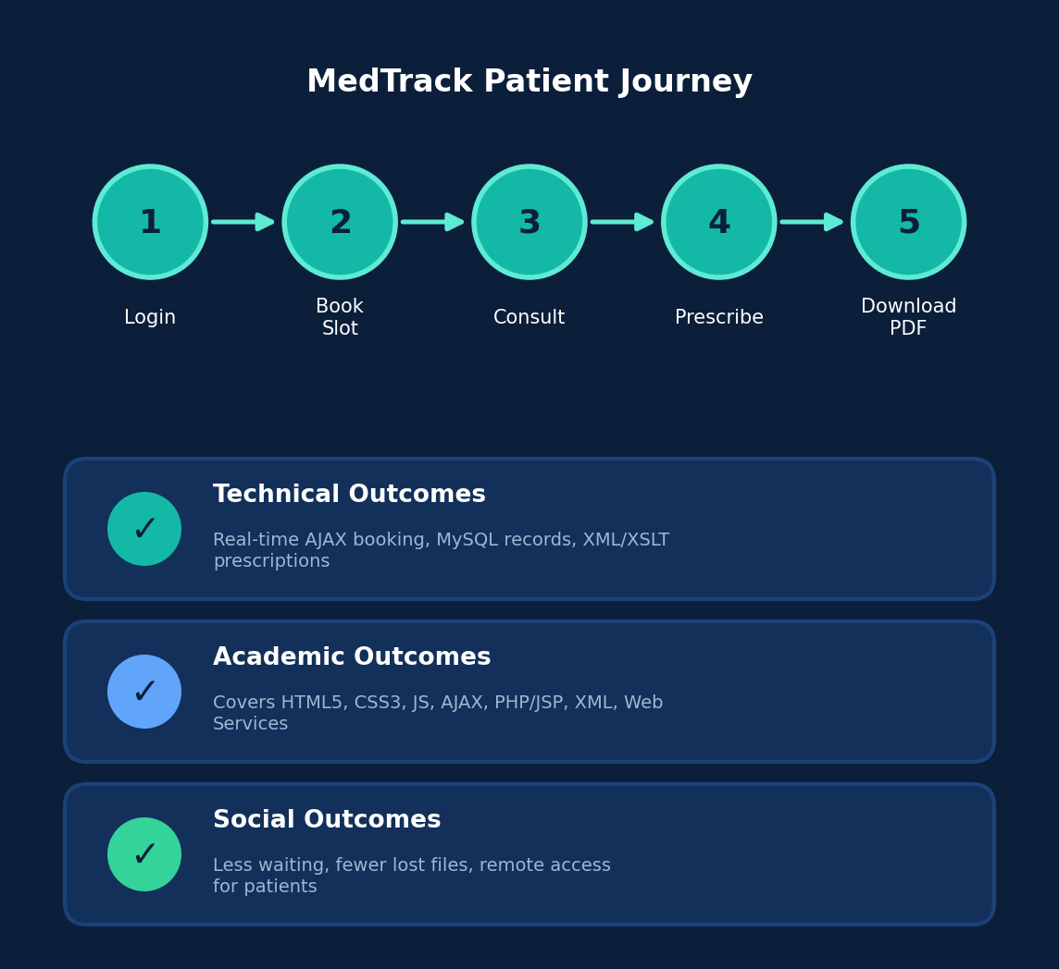
CONCLUSION
MedTrack is an integrated healthcare portal that digitises patient records, appointment booking, and report generation on one web platform. Using HTML5, CSS3, JavaScript, AJAX, PHP/JSP, MySQL, and XML, it enables real-time slot booking, structured records, and XSLT-based PDF prescriptions, reducing waiting time, lost records, and prescription errors in small and medium clinics.

Slide 9
REFERENCES
1. G. Brelstaff, S. Moehrs, P. Anedda, M. Tuveri, and G. Zanetti, “Internet Patient Records: new techniques,” J. Med. Internet Res., vol. 3, no. 1, p. e8, 2021.
2. C. S. Kumar, A. Govardhan, and C. V. Guru Rao, “Usage of XML technology in electronic health record for effective heterogeneous systems integration in healthcare,” Int. J. Med. Eng. Inform., vol. 1, no. 4, 2019.
3. H. D. D. Madushan, “Online Appointment Management System for New Philip Hospital,” BIT undergraduate thesis, University of Colombo School of Computing, 2024.
4. S. U. Kazal, B. Ahammed, M. K. Hassan, et al., “A Review on the Information System, and Development of Appointment Management System,” J. Softw. Eng. Softw. Testing, vol. 6, no. 1, 2021.
5. F. Al-Turjman, “Appointment System using Artificial Intelligence Techniques,” Near East University Journals, Jun. 2023.

Slide 10
THANK YOU

